Slide 1
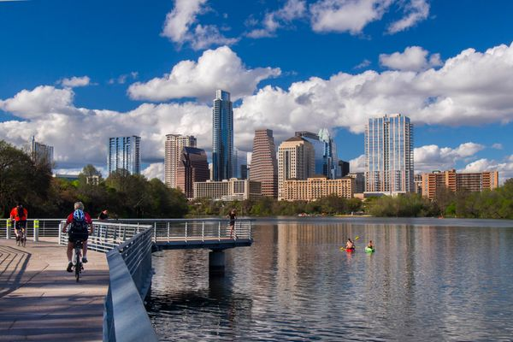
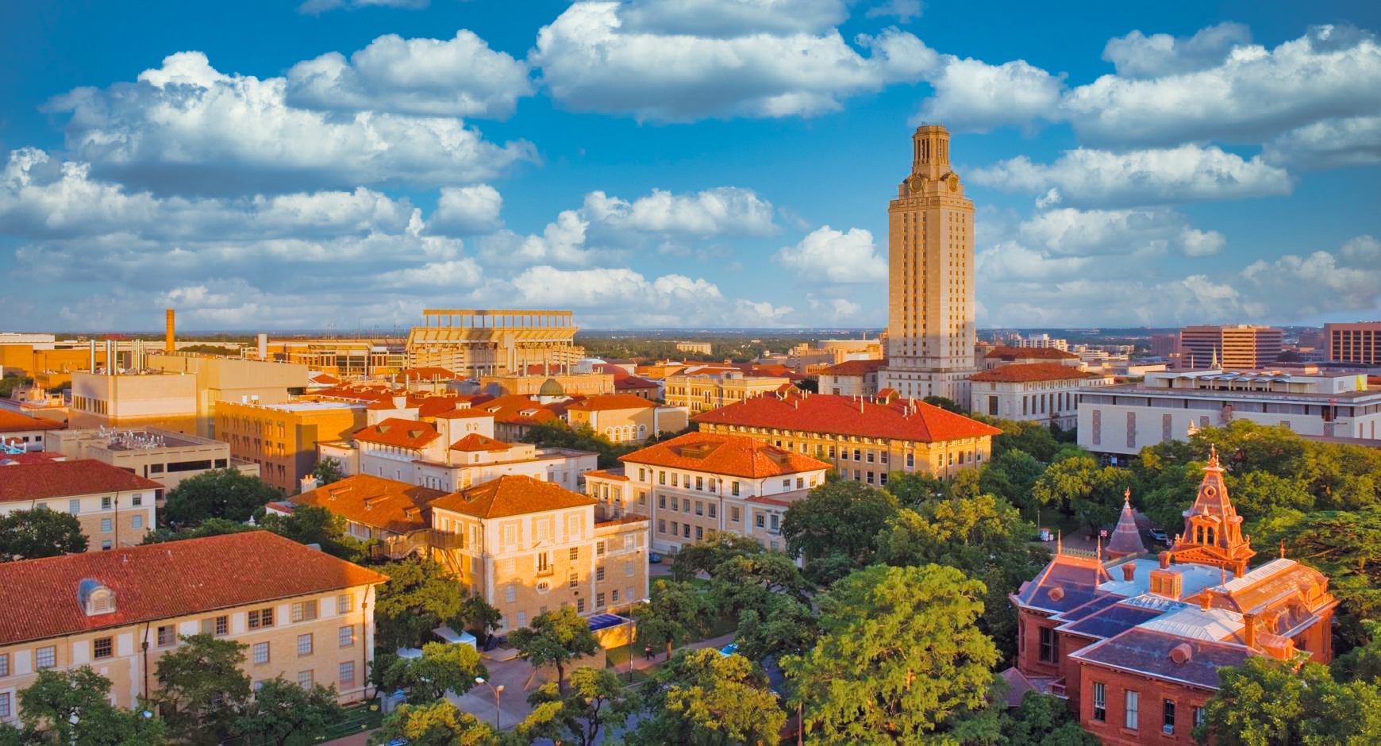
Mark your calendars! The hot hot hot event you have been waiting for…..
July 23-26, 2023
University of Texas at Austin, Austin, TX
For more details go to: https://advancingms.org/
or email: chair@advancingms.org
Organizers: Jenny Brodbelt & Dave Russell
Student Travel Awards will be available
Native MS Workshop on July 23
**This is the 3rd AMS meeting – the last one was at the Univ. of Massachusetts, Amherst in 2019, then a long COVID pause.

